Slide 1
Visual Monitoring of Subtle Human Motion
Robert F.K. Martin
Department of Computer Science
University of Minnesota
August 28, 2018

Slide 2
Outline
Motivation
Background
Object Tracking
Activity Recognition
Subtle Human Motion
Psychopathology
Initial Work
Face Gestures
Hand Gestures
Proposed Work
Contributions
Timeline

Slide 3
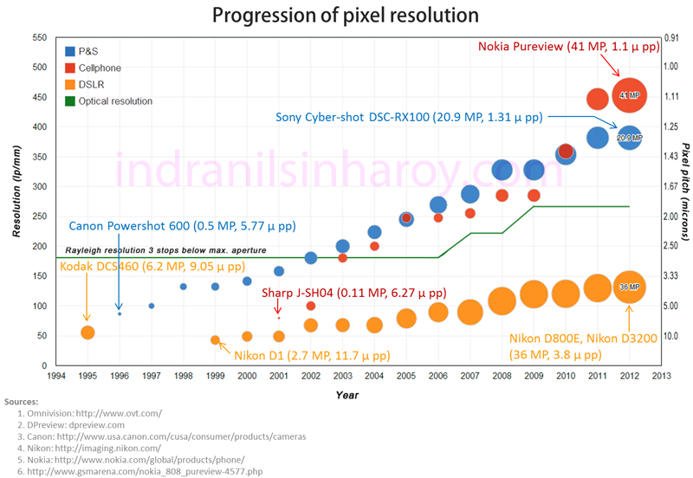
Motivation
Camera trends
https://indranilsinharoy.com/2014/02/09/pixel-resolution-in-digital-cameras/

Slide 4
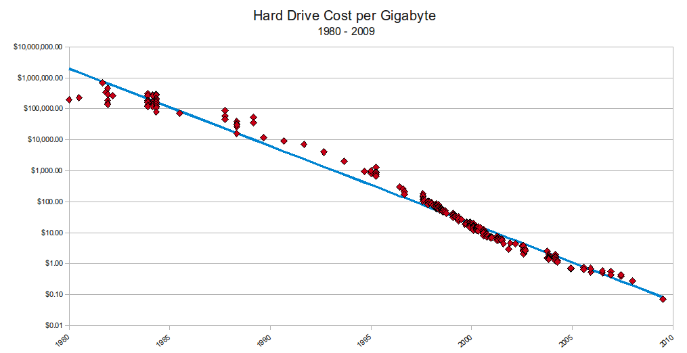
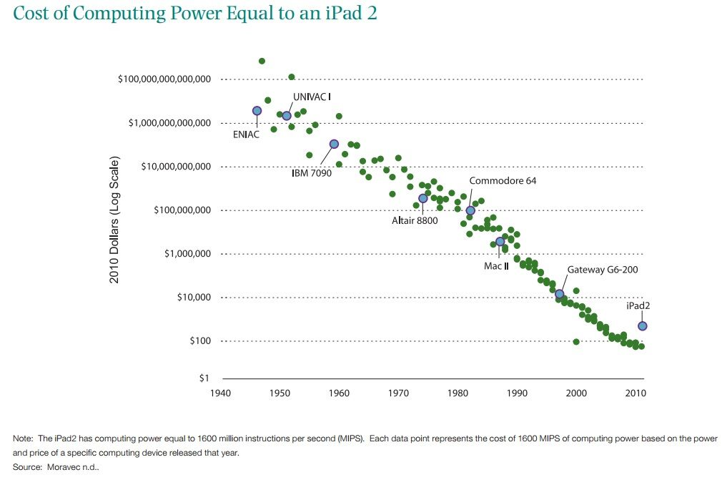
Motivation
Processing and memory trends
http://www.mkomo.com/cost-per-gigabyte
http://www.hamiltonproject.org/charts/cost_of_computing_power_equal_to_an_ipad2

Slide 5
Motivation
Automatic image/video analysis has been a useful tool for may areas
Traffic monitoring
Autonomous driving
Manufacturing/construction
Surveillance/open space monitoring

Slide 6
Motivation
Healthcare
Tissue segmentation/analysis
Automatic cell counts
Volumetric analysis of organs
Notes:
Healthcare and medicine have also benefited from computer vision advances. Image analysis has helped with segmenting different types of tissues in xrays and CT scans or detect cancerous tissue in a microscopic image. There have also been developments in the counting of various cell typs in microscopic imaging. Additionally, recent advances have been producing a volumetric analysis of medical images/MRIs of lungs, hearts, and brains.

Slide 7

Motivation
Notes:
However, for many neurological disorders only observation can be analyzed. Here is a short video of tics common in Tourette’s syndrome.

Slide 8
Motivation
Categories of tic behavior
Forceful blinking
Eye movements
Face twitches
Head shaking/rolling/jerking
Mouth movement
Should shrugging/arm movements
Vocal tics(throat clearing, grunting, sniffling)

Slide 9
Motivation
Something about observation

Slide 10
Outline
Motivation
Background
Object Tracking
Activity Recognition
Subtle Human Motion
Psychopathology
Initial Work
Face Gestures
Hand Gestures
Proposed Work
Contributions
Timeline

Slide 11
Background
Object Tracking
finding a moving object(s) over a time sequence of images.
Adaptive background modeling (Stauffer, Grimson)
Mean shift (Comaniciu, Meer)
Optical flow
SIFT/SURF

Slide 12
Background
Object Tracking
Typical problems include:
Appearance changes(shape, color)
Occlusions
Occlusion handling
Smooth trajectory
Localization
Permanence

Slide 13
Background
Activity Recognition
Subcategory of object recognition
Seeks to define the motions of a found object(person) into one or several categories
Running, walking, jumping
Shopping, playing a sport,

Slide 14
Background
Activity Recognition
Simple classifications
Complex
Apply PCA on shape analysis
Use volumetric analysis compared to template
Fails due to projection of non-rigid 3D shape onto 2D image

Slide 15
Background
Activity Recognition/Gait Analysis

Slide 16
Background
Subtle Human Motion
Also known as gestures
Meant to interact with the world(HCI) or communicate(ASL, emotions)
Tracked with instrumented clothing, body mounted accelerometers, cameras
Notes:
Gestures are elementary movements of a body part, like hand, head or facial feature like eyes or lips. Distinguish from actions(series of gestures) discussed previously.

Slide 17
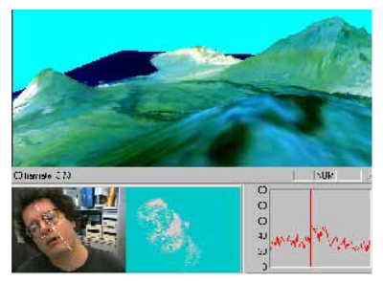
Background
Subtle Human Motion in HCI
G. R. Bradski, “Computer vision face tracking for use in a perceptual user interface," 1998
Notes:
Used color features to find the head. Modified mean shift to work at different scales. Calculated head roll via shape analysis. Limited in applicability

Slide 18
Background
Blinks – Chau, Soukupova, Grauman
Faces – Voila, Cech
Hands - Kolsch
Notes:
Chau used temporal differencing to find the eyes and determined blink rate. Also used the eyes to help locate eye brows which were also used as an system input. Soukupova used facial feature points(from cech) to calculate eye aspect ratio to determine blinks.

Slide 19
Background
Psychopathology
The behavior associated with some mental condition or disorder
Typically diagnosed through self-reporting and observation
Common disorders with observable conditions: depression, OCD, ADHD, PTSD, anxiety, Tourette’s
Notes:
What is the behavior associated with some mental condition.

Slide 20
Background
Psychopathology(Tourette’s)
Onset typically in childhood
Affects 1% of school age children
Used a standardized checklist(YGTSS)
??? Used body mounted accelerometers to quantify tics
??? Used video to analyze patients but found it too time intensive
Notes:
Onset in childhood so early detection and intervention and key in better outcomes in adulthood. Of that 1%, 1 in 5 self unaware of tics. Yale Global Tic Severity Scale – quantifies tics and assigns severity level.

Slide 21
Background
Psychopathology(OCD)
What age does this start?
Scored with CY-BOCS
Obsessions(recurrent, intrusive thoughts)
Compulsions(actions to reduce anxiety)
Hand washing
Checking
Arranging
Object preference/avoidance
Notes:
Childrens Yale-Brown Obsessive Compulsive Scale

Slide 22
Outline
Motivation
Background
Object Tracking
Activity Recognition
Subtle Human Motion
Psychopathology
Initial Work
Face Gestures
Hand Gestures
Proposed Work
Contributions
Timeline

Slide 23
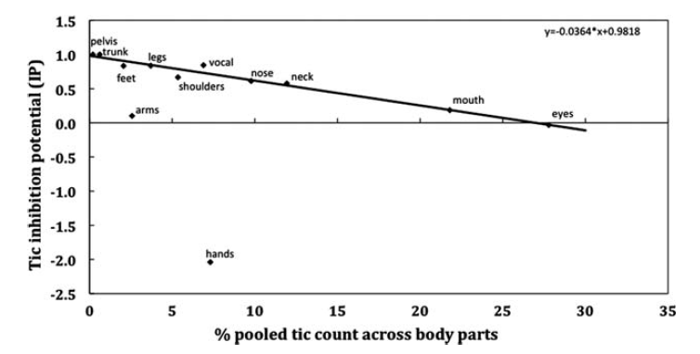
Initial Work
Facial Gestures
C. Ganos, J. Bongert, L. Asmuss, D. Martino, P. Haggard, and A. Munchau, “The somatotopy of tic inhibition: here and how much?“ MOVEMENT DISORD, vol. 30, no. 9, pp. 1184{9, 8 2015, 2015 International Parkinson and Movement Disorder Society.

Slide 24
Initial Work
Facial Gestures
Face tics account for 45% of typical tic behavior
Blinks are involuntary(15-20/min)
Blinking tics are typically forceful and non-periodic

Slide 25
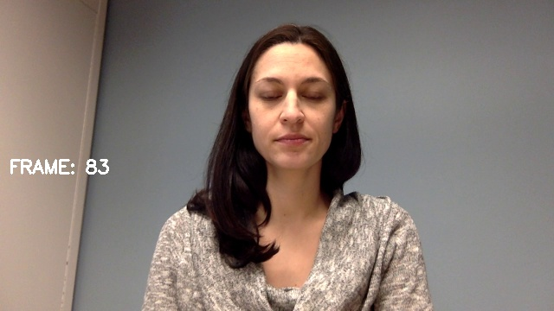
Initial Work
Facial Gestures
Record subject sitting still
View from mid-torso and above
Need to be robust to lighting and scene variations

Slide 26
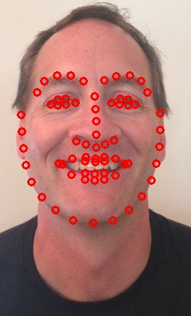
Initial Work
Facial Gestures
Use facial landmark detection as implemented in dlib library for Python
Provides x,y of 68 features points
To detect forceful blinking, measure eye “openness” and shape and position of eyebrows
To detect head motion, calculate gaze direction
Kazemi, V., & Sullivan, J. (2014). One millisecond face alignment with an ensemble of regression trees. 2014 IEEE Conference on Computer Vision and Pattern Recognition, 1867-1874.

Slide 27
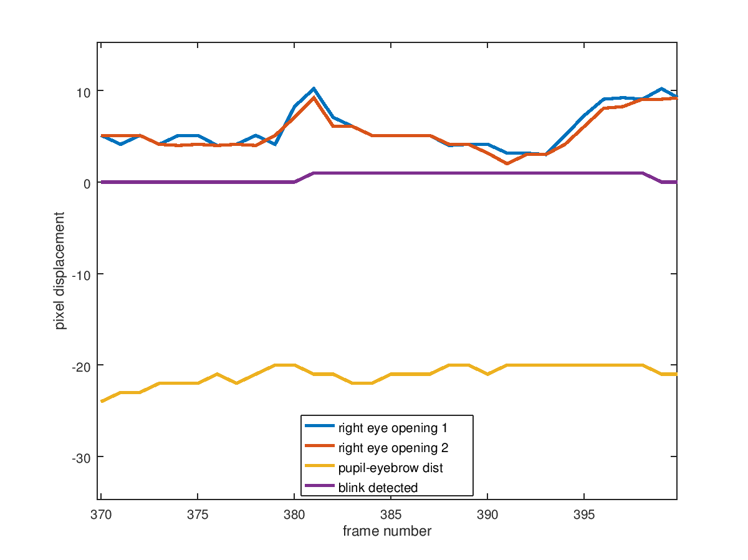
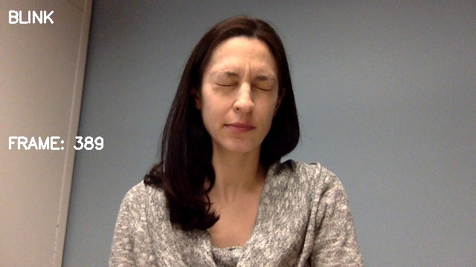
Initial Work
Facial Gestures(blinks)

Slide 28
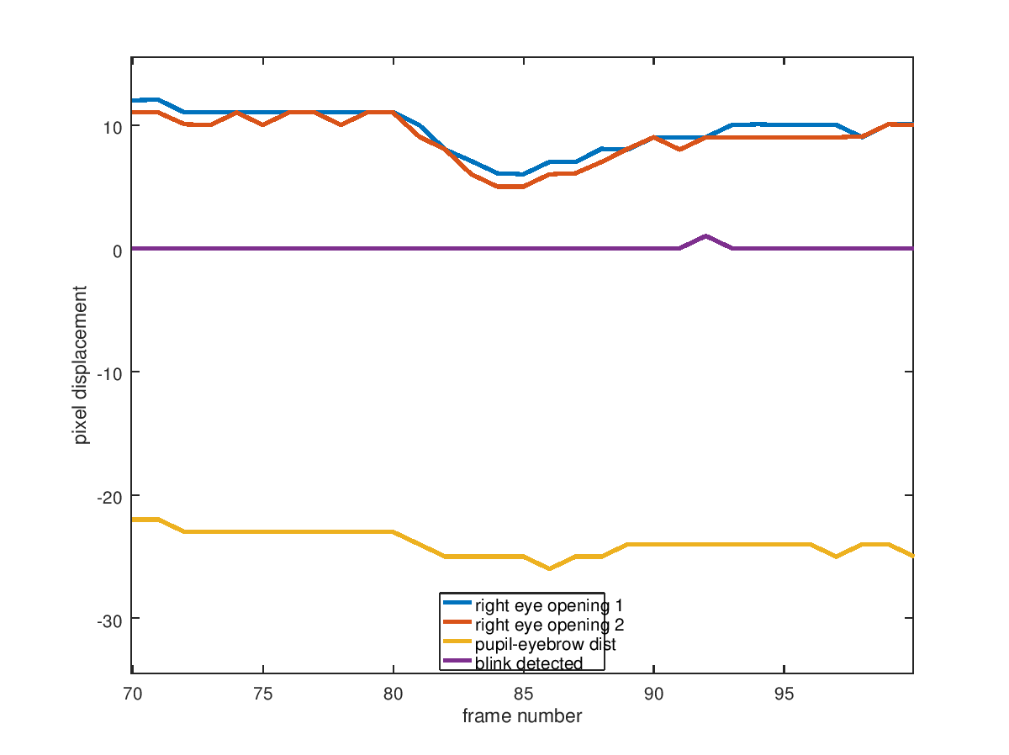
Initial Work
Facial Gestures(blinks)

Slide 29
Initial Work
Facial Gestures(blinks)
Work good as a first pass heuristic
But may not be applicable to general population or robust to all tics
Incorporate more landmarks
Notes:
overfitting on normative population

Slide 30
Initial Work
Facial Gestures(head movement)
Use subset of landmarks to compute gaze direction
Assume planar face

Slide 31
Initial Work
Facial Gestures(head movement)
Use subset of landmarks to compute gaze direction
Assume planar face
Compute plane normal given camera calibration
Calculate large or fast deviations from “straight ahead” gaze

Slide 32
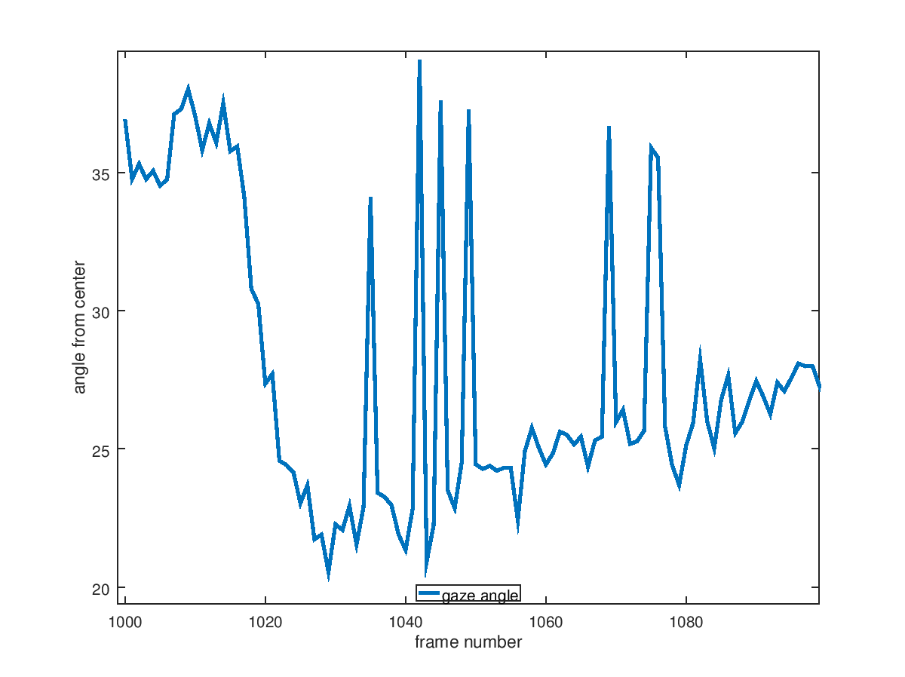
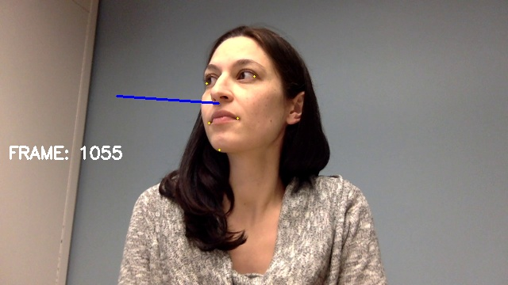
Initial Work
Facial Gestures(head motion)

Slide 33
Initial Work
Hand Gestures
OCD is manifested in certain behaviors, some observable
Create a situation that might elicit some of those behaviors
Given some objects, ask the subject to arrange them in a particular way and measure results

Slide 34
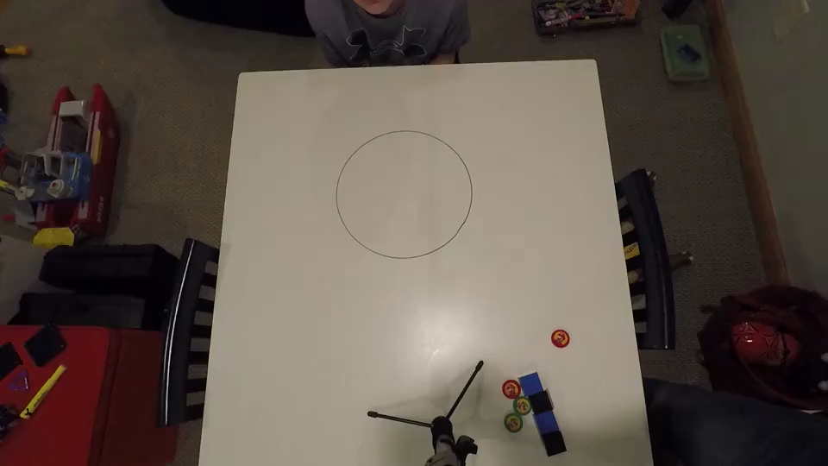
Initial Work
Hand Gestures

Slide 35
Initial Work
Hand Gestures
Use top down view to minimize object occlusion
Align the objects with either circle or line
Use a simple surface and monocolored objects to minimize segmentation difficulties

Slide 36
Initial Work
Hand Gestures
Metrics
Engagement: touching and moving
Total time of engagements
Engagement time per object
Total distance moved
Arrangement: how close does the shape match
Line
Circle
Notes:
Touching should correspond to a checking behavior and moving may correspond to an object preference or ordering. Not only an interesting study in terms of OCD, but also interesting in a subject/object interaction. Use regression to match the lines, mean squared error, and angle between lines. Circle – distance between centers and diameter difference. And for both, stddev of distance between objects.

Slide 37
Initial Work
Hand Gestures
Need to calibrate scene
Need to focus on set-up to bootstrap good segmentation
No explicit tracking of arms or hands and occlusions will occur
Assume occlusions are a touching behavior

Slide 38
Outline
Motivation
Background
Object Tracking
Activity Recognition
Subtle Human Motion
Psychopathology
Initial Work
Face Gestures
Hand Gestures
Proposed Work
Contributions
Timeline

Slide 39
Proposed Work
Video
Need to collect more videe
Ground truth the videos
Notes:
Capture people who experience OCD/tic behaviors and not. Our training videos may not have captured true nuance of tic or OCD behaviors.

Slide 40
Proposed Work
Scene variety
Busy backgrounds
Wider variety of shapes, sizes, and colors of objects
If possible, examine other camera placement
Notes:
Busy backgrounds may be distracting to those who suffer from OCD. It is also a challenging computer vision problem. Examine other camera placement to make this as applicable to general public as possible.

Slide 41
Proposed Work
Additional face landmarks
Busy backgrounds
Wider variety of shapes, sizes, and colors of objects
If possible, examine other camera placement
Notes:
Busy backgrounds may be distracting to those who suffer from OCD. It is also a challenging computer vision problem. Examine other camera placement to make this as applicable to general public as possible.

Slide 42
Proposed Work
Advanced learning
HMM
RNN/LSTM
Notes:
Busy backgrounds may be distracting to those who suffer from OCD. It is also a challenging computer vision problem. Examine other camera placement to make this as applicable to general public as possible.

Slide 43
Proposed Work
Dyadic Interactions
Notes:
Busy backgrounds may be distracting to those who suffer from OCD. It is also a challenging computer vision problem. Examine other camera placement to make this as applicable to general public as possible.

Slide 44
Outline
Motivation
Background
Object Tracking
Activity Recognition
Subtle Human Motion
Psychopathology
Initial Work
Face Gestures
Hand Gestures
Proposed Work
Contributions
Timeline

Slide 45
Contributions
Medical Observation

Slide 46
Contributions
Subject/Object interaction and tracking

Slide 47
Outline
Motivation
Background
Object Tracking
Activity Recognition
Subtle Human Motion
Psychopathology
Initial Work
Face Gestures
Hand Gestures
Proposed Work
Contributions
Timeline

Slide 48
Timeline
August 2018 – March 2019
Gather and ground truth tic videos of control and diagnosed population
Gather videos of simple arranging task
Create processing framework for batch processing video
Create software for metrics and camera calibration

Slide 49
Timeline
April 2019 – October 2019
Process tic and arranging videos
Refine tracking algorithms and metrics as needed
Record additional arranging task videos under more conditions

Slide 50
Timeline
November 2019 – May 2020
Investigate HMM/RNN for use with facial features for more advances tic analysis
Analyze new arranging task videos

Slide 51
Timeline
June 2020 – December 2020
Review final results
Write final thesis

Slide 52
Thank You!
Questions?

